Slide 1

B.TECH PROJECT MID-TERM PRESENTATION 2017
HUMAN EMOTION DETECTION FROM FACIAL CHANGES
Project id:12166
By
Abhishek Kumar Soni Roll# CSE 201418611
Alokik Pathak Roll# CSE 201440583
Under the guidance of
Prof. Bhawani Shankar Pattnaik
Abhishek Kr. Soni(CSE201418611) & Alokik Pathak (CSE201440583)
Notes:
B-TECH PROJECT MID-SEM PRESENTATION 2011
BY KHUSHBU KHAN & ISAN SAHOO

Slide 2
B.TECH PROJECT MID-TERM PRESENTATION 2017
Content
Introduction
Required Components
Mechanism
Types Of Facial Expression
Working Sample
Output
Future Work
References
Abhishek Kr. Soni(CSE201418611) & Alokik Pathak (CSE201440583)
Notes:
B-TECH PROJECT MID-SEM PRESENTATION 2011
BY KHUSHBU KHAN & ISAN SAHOO
2

Slide 3
B.TECH PROJECT MID-TERM PRESENTATION 2017
Introduction
Our aim to built emotional intelligent Bot.
A Bot which can recognize its Master & can detects his/her emotion from their emotions and perform tasks accordingly.
Bot can detect emotions such as joy, anger, sorrow, surprise, etc.
Abhishek Kr. Soni(CSE201418611) & Alokik Pathak (CSE201440583)
Notes:
B-TECH PROJECT MID-SEM PRESENTATION 2011
BY KHUSHBU KHAN & ISAN SAHOO
3

Slide 4
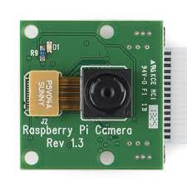
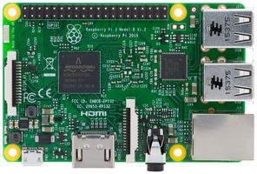
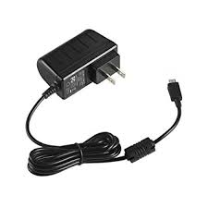






B.TECH PROJECT MID-TERM PRESENTATION 2017
Required Components
Hardware’s
ResberryPi3
Pi Camera
Ethernet cable
SD card with Jessie operating system installed
Adapter
Software's
Putty
Python
Google Cloud Vision API
OpenCV
TensorFlow
Abhishek Kr. Soni(CSE201418611) & Alokik Pathak (CSE201440583)
Notes:
B-TECH PROJECT MID-SEM PRESENTATION 2011
BY KHUSHBU KHAN & ISAN SAHOO
4

Slide 5
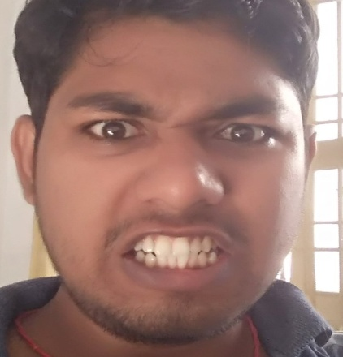
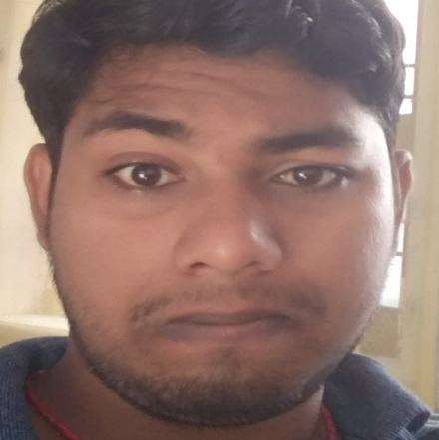
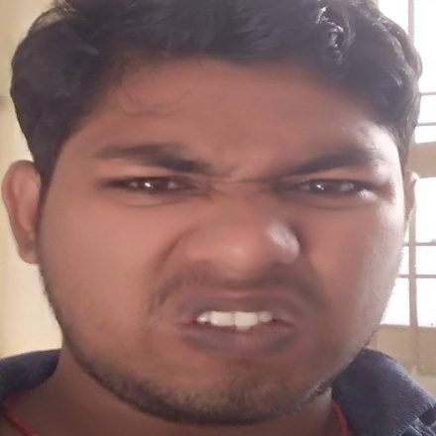
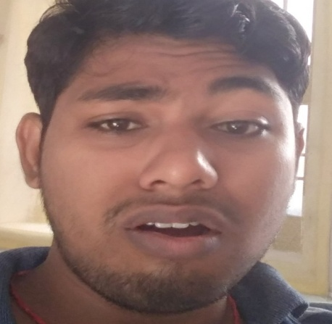
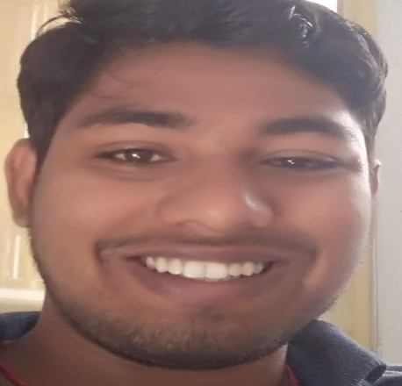
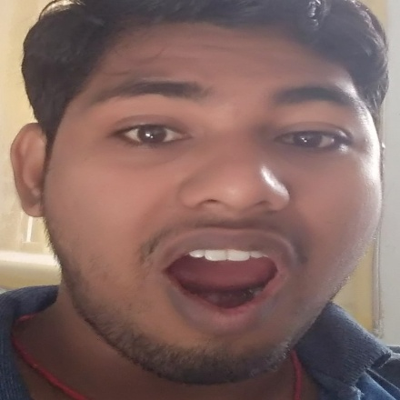
B.TECH PROJECT MID-TERM PRESENTATION 2017
Types Of Facial Expression
1. ANGER 2.CONTEMPT 3.DISGUST
4.FEAR 5.HAPPY 6.SURPRISE
Abhishek Kr. Soni(CSE201418611) & Alokik Pathak (CSE201440583)
Notes:
B-TECH PROJECT MID-SEM PRESENTATION 2011
BY KHUSHBU KHAN & ISAN SAHOO
5

Slide 6
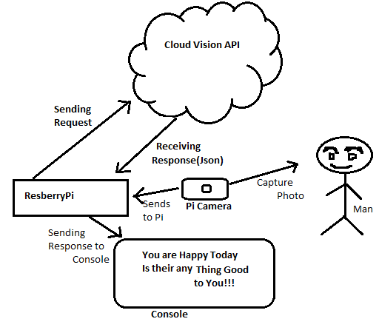
B.TECH PROJECT MID-TERM PRESENTATION 2017
Mechanism
Abhishek Kr. Soni(CSE201418611) & Alokik Pathak (CSE201440583)
Notes:
B-TECH PROJECT MID-SEM PRESENTATION 2011
BY KHUSHBU KHAN & ISAN SAHOO
6

Slide 7
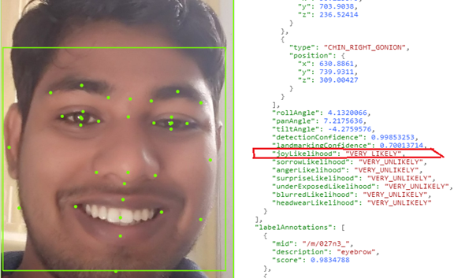
B.TECH PROJECT MID-TERM PRESENTATION 2017
Working Sample
Abhishek Kr. Soni(CSE201418611) & Alokik Pathak (CSE201440583)
Notes:
B-TECH PROJECT MID-SEM PRESENTATION 2011
BY KHUSHBU KHAN & ISAN SAHOO
7

Slide 8
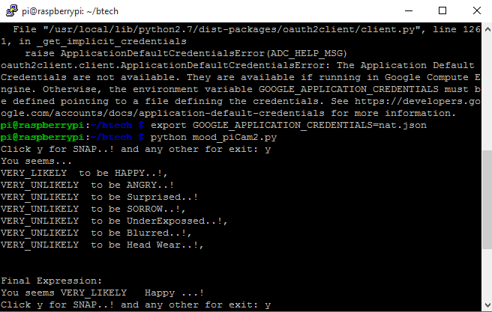
B.TECH PROJECT MID-TERM PRESENTATION 2017
Output
Abhishek Kr. Soni(CSE201418611) & Alokik Pathak (CSE201440583)
Notes:
B-TECH PROJECT MID-SEM PRESENTATION 2011
BY KHUSHBU KHAN & ISAN SAHOO
8

Slide 9
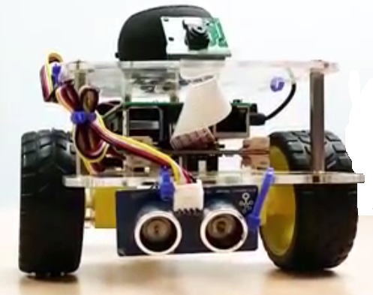
B.TECH PROJECT MID-TERM PRESENTATION 2017
Future Work
Training model with collected data in Tensor Flow.
Face & Emotion Recognition.
Working on Speech API for response.
Integrating model into Robot.
Abhishek Kr. Soni(CSE201418611) & Alokik Pathak (CSE201440583)
Notes:
B-TECH PROJECT MID-SEM PRESENTATION 2011
BY KHUSHBU KHAN & ISAN SAHOO
9

Slide 10
B.TECH PROJECT MID-TERM PRESENTATION 2017
Reference
[1] Google Cloud Platform
https://cloud.google.com/
[2] Google Cloud Vision API
https://cloud.google.com/vision/
[3] Google Cloud Speech API
https://cloud.google.com/speech/
[4] GoPiGo Tutorial and its Documentation (By Dexter Industries)
https://www.dexterindustries.com/gopigo3-tutorials-documentation/
[5] TensorFlow (Codelabs) https://codelabs.developers.google.com/codelabs/tensorflow-for-poets/
[6] TensorFlow(An open-source s/w library for Machine Intelligence)
https://www.tensorflow.org
[7] OpenCV library
www.openCV.org
Abhishek Kr. Soni(CSE201418611) & Alokik Pathak (CSE201440583)
Notes:
B-TECH PROJECT MID-SEM PRESENTATION 2011
BY KHUSHBU KHAN & ISAN SAHOO
10

Slide 11
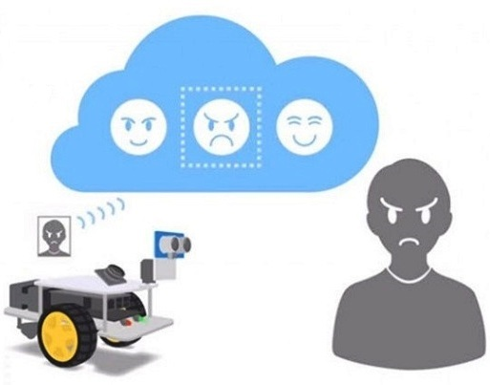
B.TECH PROJECT MID-TERM PRESENTATION 2017
THANK YOU !!
Abhishek Kr. Soni(CSE201418611) & Alokik Pathak (CSE201440583)
Notes:
B-TECH PROJECT MID-SEM PRESENTATION 2011
BY KHUSHBU KHAN & ISAN SAHOO
11

